Slide 1
FLImBRUSH data processing

Slide 2
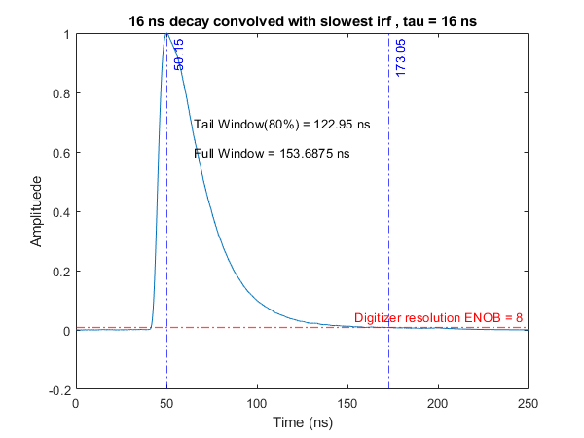
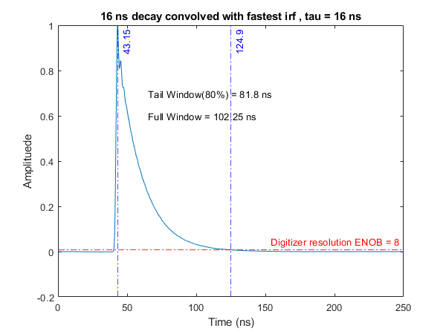
truncation window for PpIX
 | ENOB=7(manual) | ENOB=8 | From measurement data
Noise | 0.0156 | 0.0078 | 0.035
I just took the middle road

Slide 3
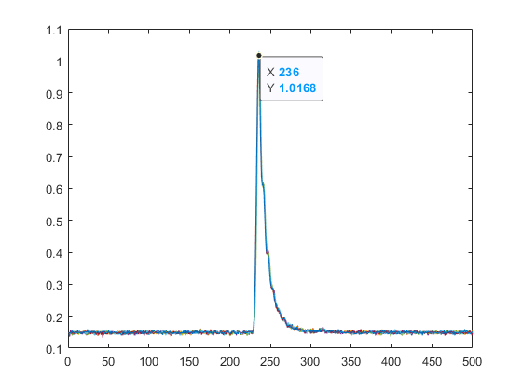
FLImBRUSH acquisition window
Current FLImBRUSH acquisition:
Total: 500 points*0.4 ns/points = 200 ns.
Data after peak: 106 ns (17ns short for slowest iRF).
Solution: We can adjust the trigger delay by 50ns.

Slide 4
Alpha vs Condition value
Sampling rate (GS/s) | Truncation length | Eps = 1.01 | Eps = 1.0001
20 | 3080 | 0.9837 | 0.9808
10 | 1540 | 0.9677 | 0.9619
5 | 770 | 0.9365 | 0.9252
2.5 | 385 | 0.877 | 0.856
We have been using 1.0001 for the past

Slide 5
Simulation
Lifetime range: 0.3-20ns
Gaussian white noise: 55dB SNR (good approximatin for FLImBRUSH)
Truncation window = 154ns (PpIX)

Slide 6
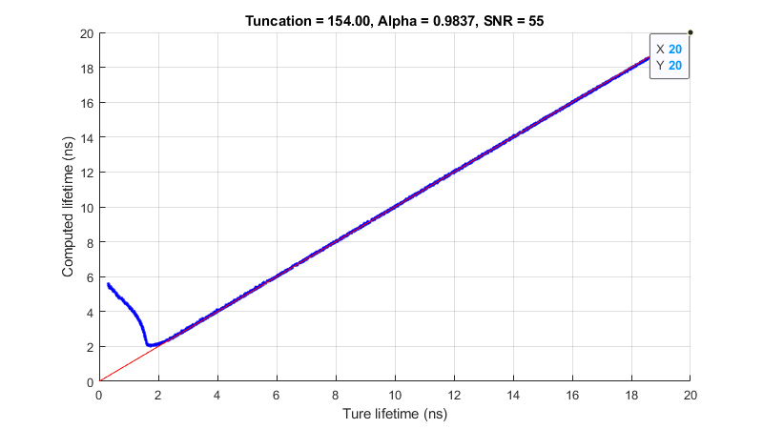
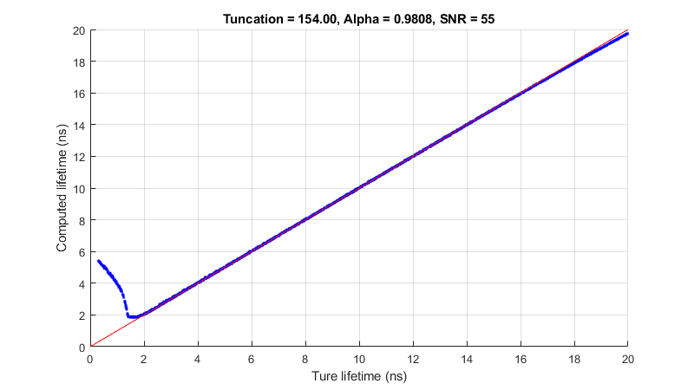
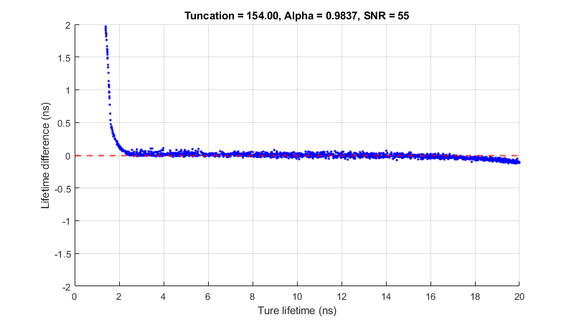
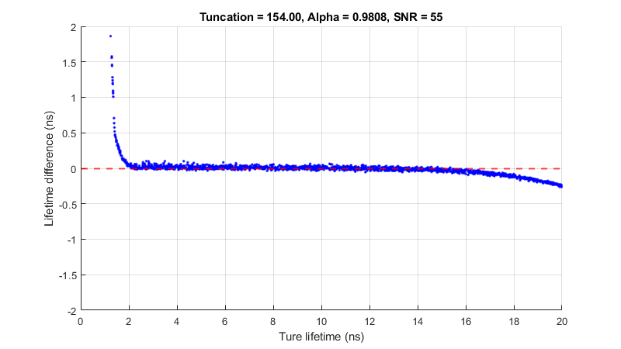
20 GS/s

Slide 7


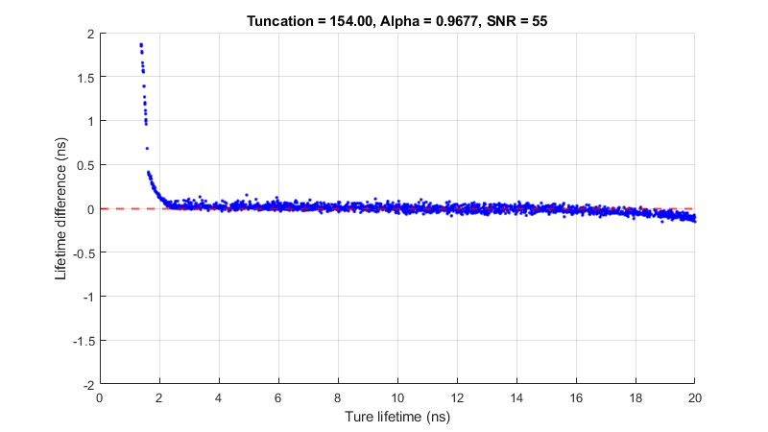
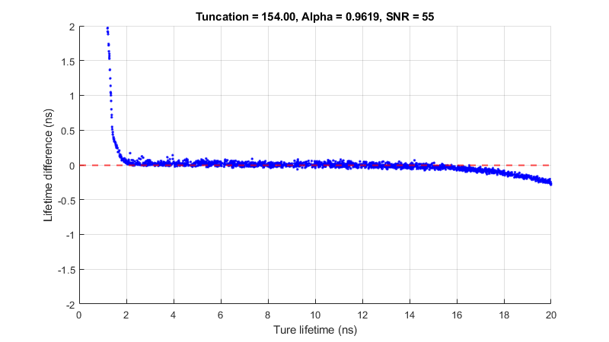
10 GS/s

Slide 8


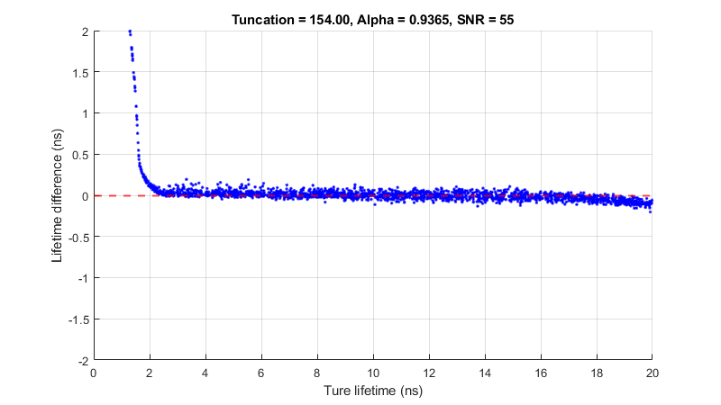
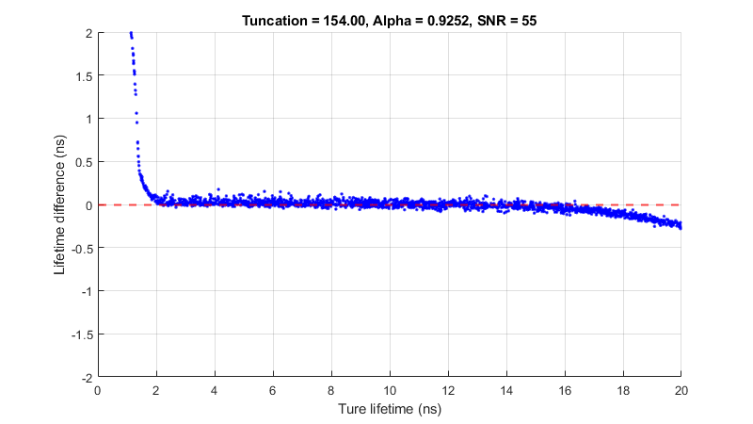
5 GS/s

Slide 9
Observation
Adding noise increase the std of lifetime (how surprise :p)
The effect of condition value (1.01 vs 1.0001) is minimum. The biggest different is for lifetime > 16ns.
Small bias(~0.1ns) as a function of lifetime(shorter lifetime, longer lifetime)

Slide 10
Result from dye measurements
2 decon setting:
154ns window(PpIX) with its corresponding alpha
54.4ns window(matching V4) with its corresponding alpha

Slide 11
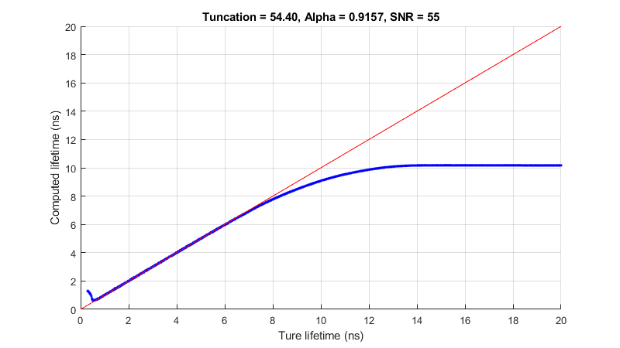
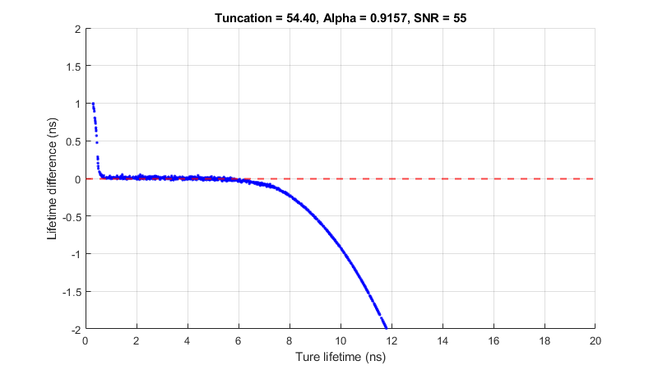
V4: 12.5 GS/s, 54.4ns(680 points),alpha = 0.916

Slide 12


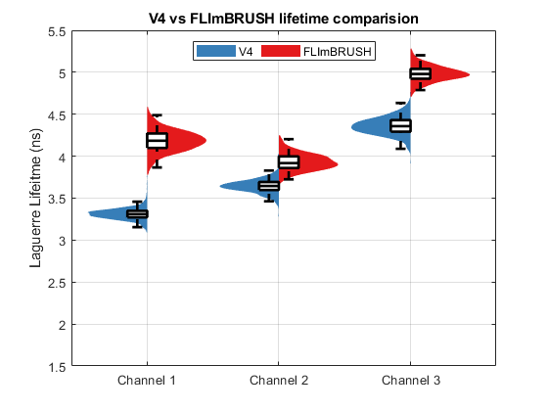
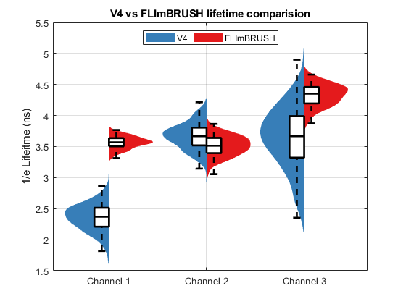
FLImBRUSH: 5 GS/s 154 ns alpha = 0.9252

Slide 13
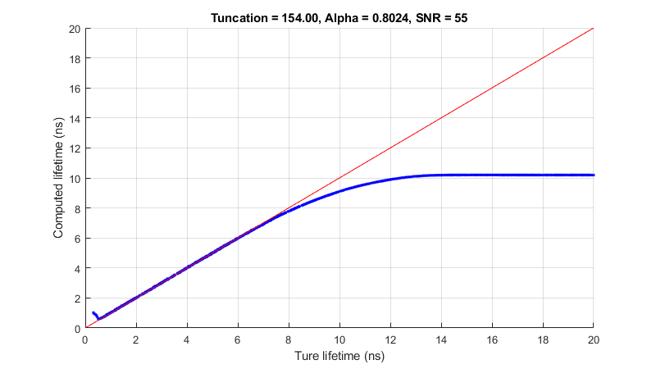
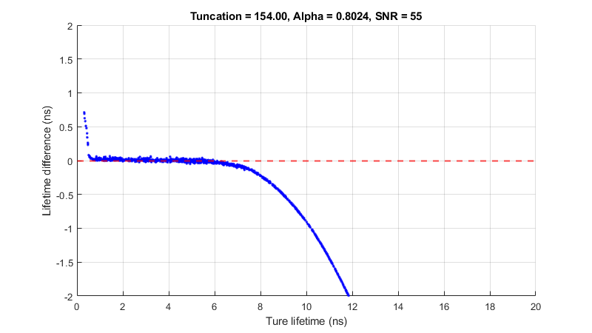
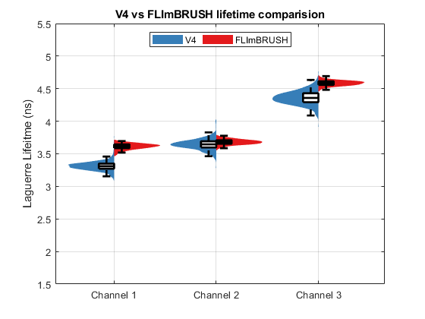
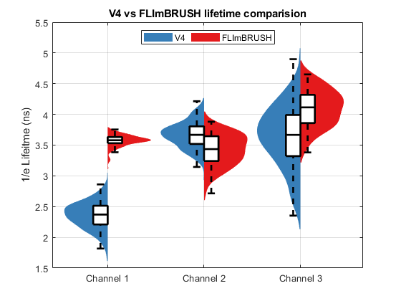
FLImBRUSH: 5 GS/s 154 ns alpha = 0.8024

Slide 14
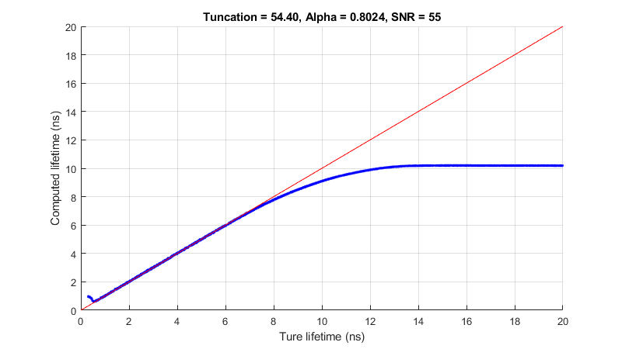
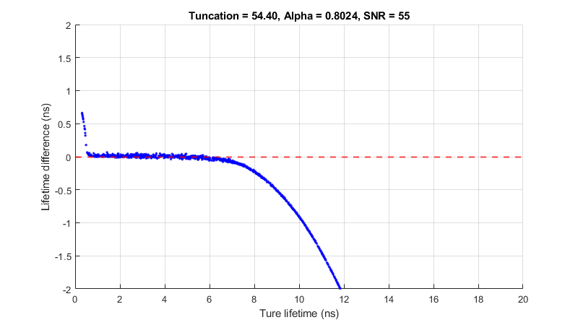
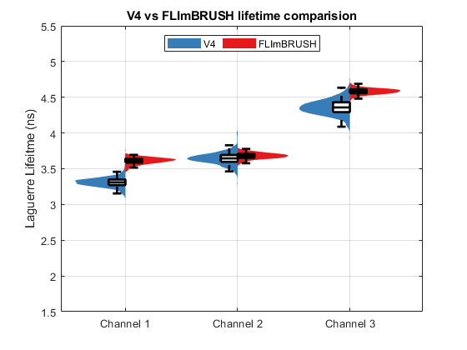
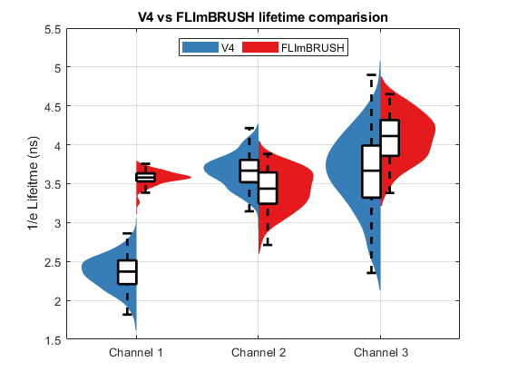
FLImBRUSH: 5 GS/s 54.4 ns alpha = 0.8024

Slide 15
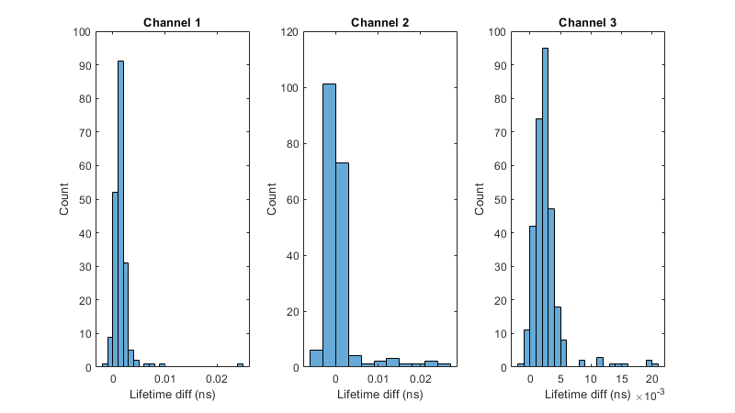
5 GS/s, 54.4 vs 154 ns, alpha = 0.8024
154ns lifetime – 54.4ns lifetime

Slide 16
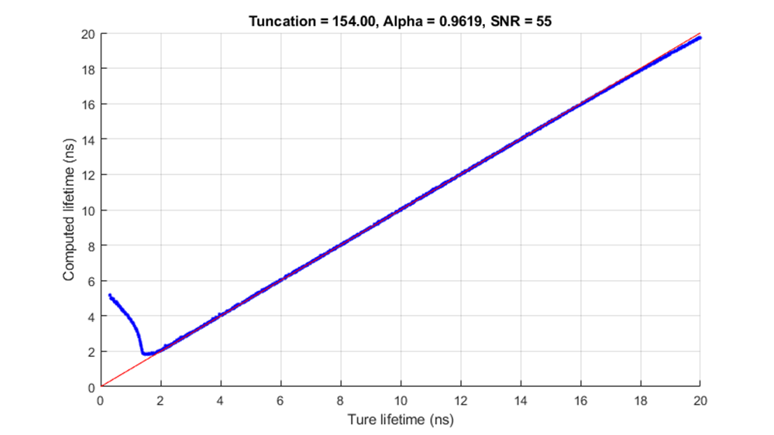
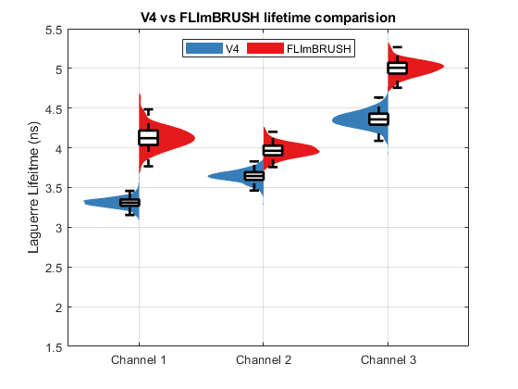
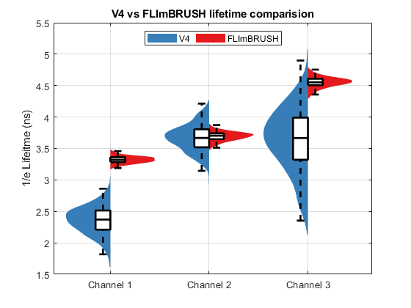
FLImBRUSH: 10 GS/s 154 ns alpha = 0.9619

Slide 17
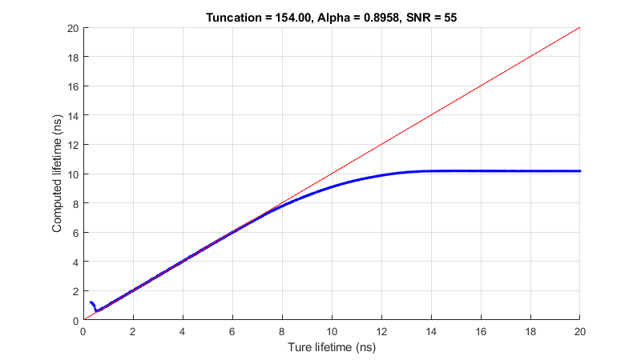
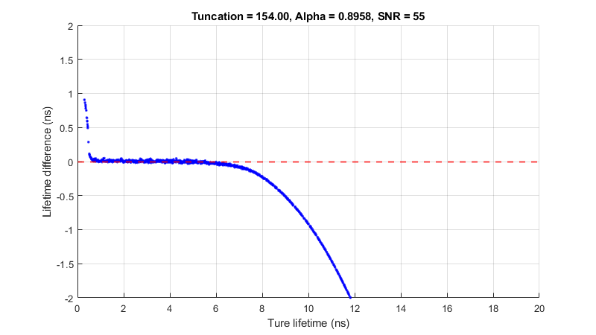
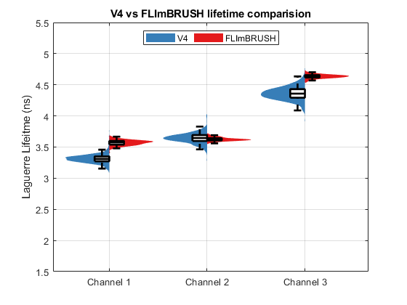
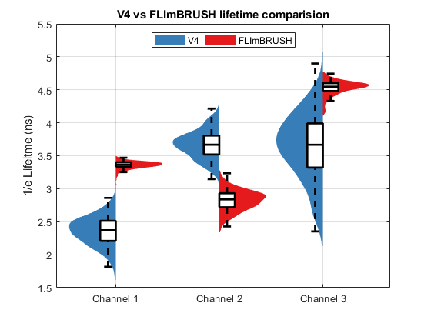
FLImBRUSH: 10 GS/s 154 ns alpha = 0.8958

Slide 18




FLImBRUSH: 10 GS/s 54.4 ns alpha = 0.8958

Slide 19
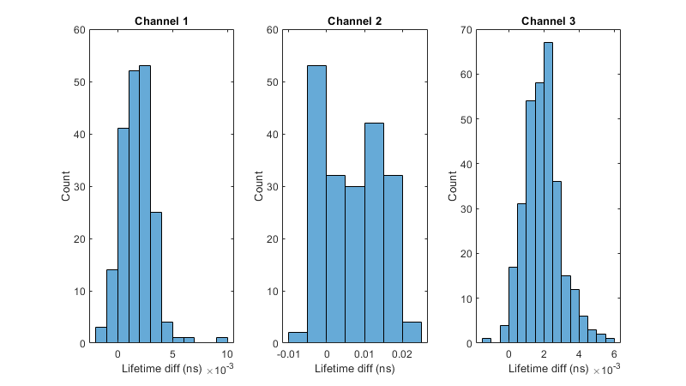
10 GS/s, 54.4 vs 154 ns, alpha = 0.8958
154ns lifetime – 54.4ns lifetime

Slide 20
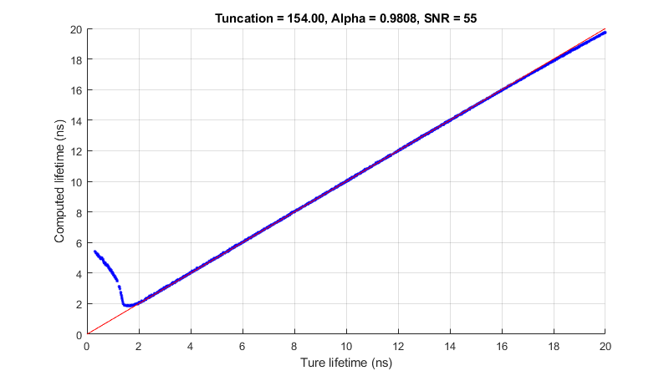

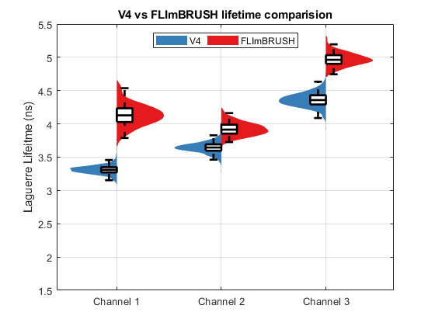
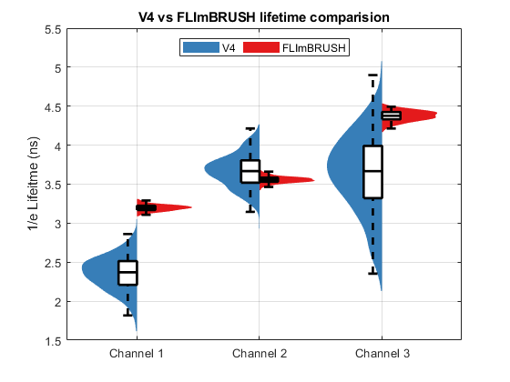
FLImBRUSH: 20 GS/s 154 ns alpha = 0.9808

Slide 21


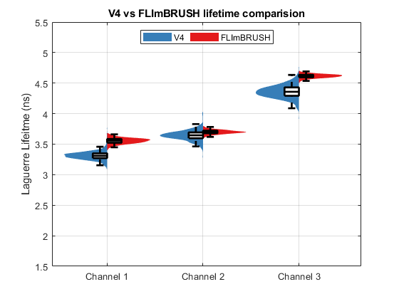
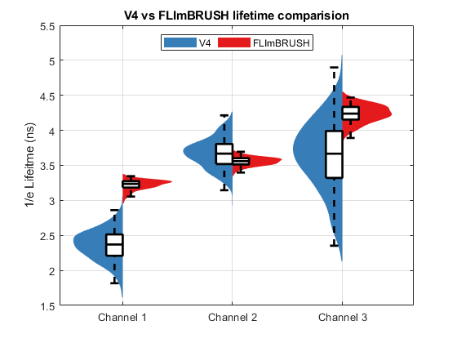
FLImBRUSH: 20 GS/s 154 ns alpha = 0.9465

Slide 22



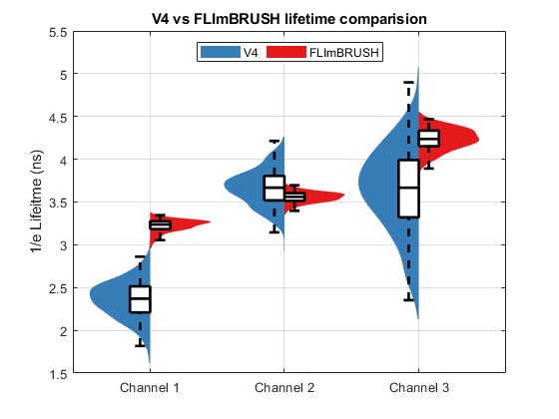
FLImBRUSH: 20 GS/s 54.4 ns alpha = 0.9465

Slide 23
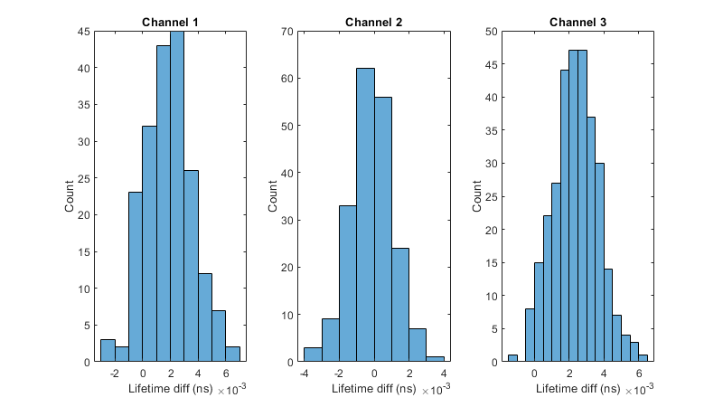
20 GS/s, 54.4 vs 154 ns, alpha = 0. 9465
154ns lifetime – 54.4ns lifetime

Slide 24
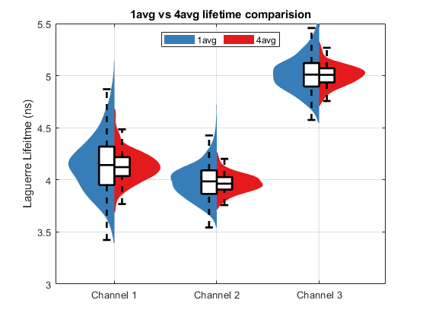
10 GS/s 154 ns alpha = 0.9619
Effect of noise in the tail
So it is not the averaging

Slide 25
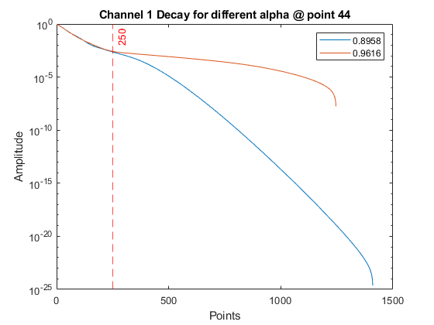
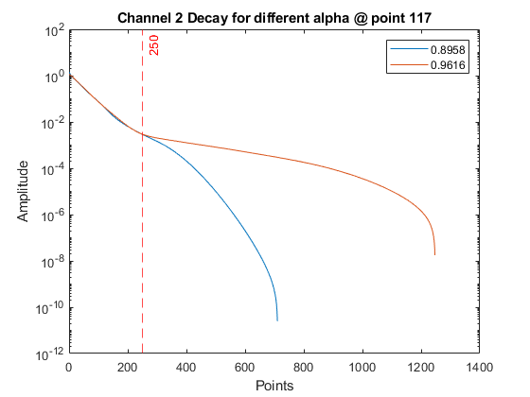
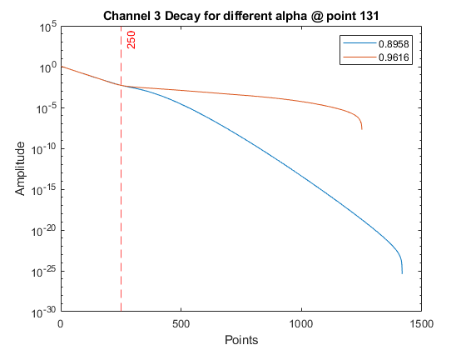
Decays: 10 GS/s 154ns different alpha
The decay always deviate around 250 point(25ns) for all channels, related to when decay drop below noise?
The data have different length because the tail of the data sometime go to very small negative value less than ~-10e-7, which can not be displayed in log scale
I didn’t notice any pattern for the when negative value happens, but it also present in V4 data as well. I think it might be related to the tolerance of the algorithm.

Slide 26
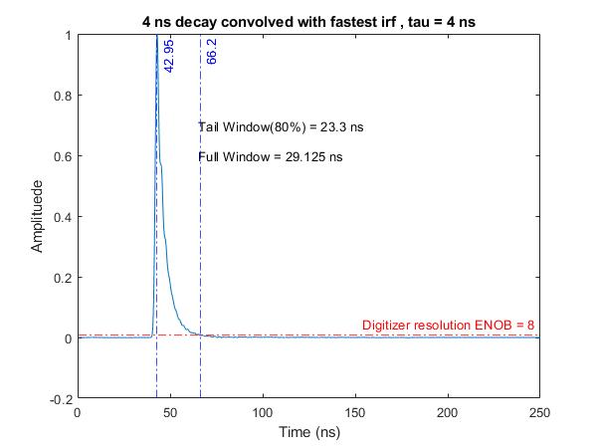
If we use a representative irf based on data and compute the truncation length? (irf for all 3 channel are similar)
~ 25ns, the data drop below noise

Slide 27
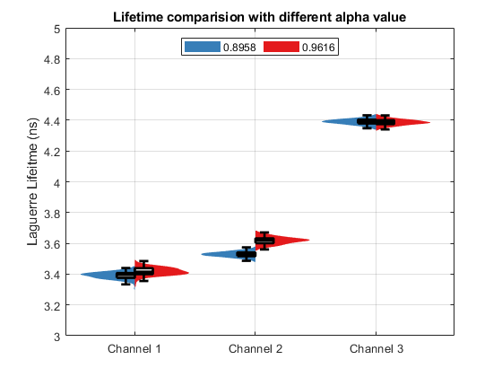
What if we truncate the decays to 250 points (25ns) and compute lifetime?
The lifetime is with in 0.1ns
So the noise in the tail cause the decay to drag long.

Slide 28

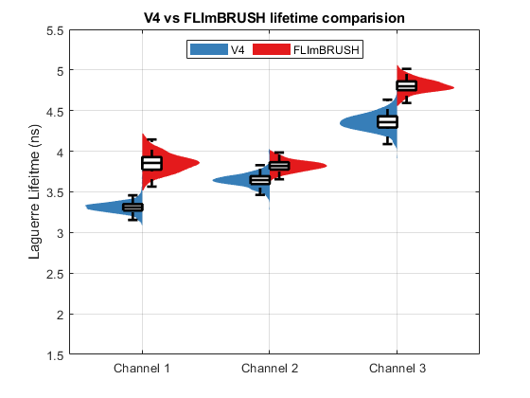
DC

Slide 29
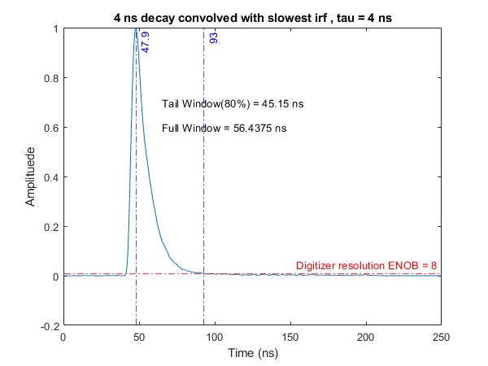
Summary
Using 154ns window for 4ns decay cause more harm than good
The lifetime value is consistently longer for all sampling rate.
The std of deconvolved data is larger. Consistent across sampling rate. This mean the alignment of waveform is no longer the limiting factor for std.
Should use a truncation window that match the expected lifetime
Hard to tell why 1/e lifetime seems better for long window

